Slide 1
Amulets in Ancient Egypt
Understand and Creating “Lucky Charms”

Slide 2
Think About This:
Do you have any object that has special “lucky” powers or represents something powerful or religious?
Write this object down on the margin of your paper and during the lesson think about what makes it special…
Notes:
Give a few minutes for students to think about and respond to the question. Answers will be used later in the lesson, so don’t share now.

Slide 3
Amulets in Ancient Egypt
    In your notebooks write the following questions
What is an Amulet?
What are three major ways amulets were used?
What made the amulet special?
Metropolitan Museum of Art
Notes:
Have students write the questions in their notebooks, leaving space for each answer, then click on the hyperlink and have them answer the questions.

Slide 4
Amulets
Created to be worn or carried
Possessed magical or protective powers
The shape, words, material, color, all held importance
What are three examples of amulets people might carry today?
What makes these objects powerful?
Notes:
After viewing the website and going over answers review the facts with students, then have them answer the 2 questions in their notes.

Slide 5
Color and Materials in Jewelry
To the ancient Egyptians, materials and colors that reflected certain ideas had symbolic meaning. Pigments and raw materials were obtained from many sources in the Nile Valley and as trade goods from people who lived around the Mediterranean Sea and beyond. The next slide is a list of the colors and their symbolism most important to the ancient Egyptians.

Slide 6
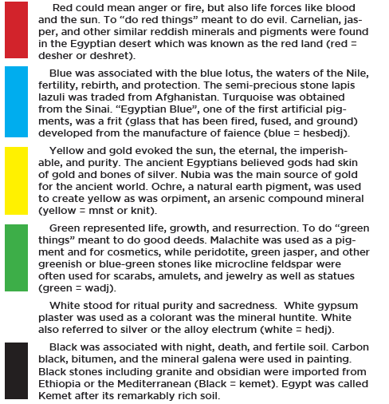
A Material World…
Looking at the chart:
Identify the importance of the different colors.
Note where the raw materials came from.
Why might materials from far away be more valuable?
Notes:
Looking at the chart from the Albany Institute of History & Art, identify where the materials came from, and the relationship of color to different powers. Stress to students the distances and difficulties of travel and trade across the Mediterranean Sea and Middle East during this time period, and this factors into the value of materials. Scarcity, distance traveled, difficulty of mining often increases value.

Slide 7
Amulets Today
What is its purpose?
How is it carried?
What is it made of?
What color?
Words or symbols?
Now you are going to create your own amulet.
Think about the things you have seen and discussed today as you create.
Your amulet should be either worn or stand alone, and will have some special or magical power.
As you create your amulet you must answer the questions.
When finished, everyone will present their amulet to the class.
Notes:
Explain project to students, disseminate materials (paper, coloring materials, etc) and leave questions up for their reference. On second day students should present their creations and explain their answers to the questions.

